Slide 1





Analysis of PJM Interconnection Transition Cycle 1
Bill Louer
LinkedIn Profile
9/5/2024

Slide 2
Outline
Introduction and Background
Objectives
Exploratory Data Analysis
Projects with Lowest Interconnection Cost
Conclusions
Appendix
Acknowledgements

Slide 3
Introduction & Background
PJM transitioned from a serial to a cluster study approach.
PJM divided projects currently in the series queue into two clusters:
Transition Cluster 1: AE1, AE2, AF1, AF2, AG1
Transition Cluster 2: AG2, AH1
PJM analyzed the first cluster of projects (TC-1) and recently completed Phase 1 analysis.
This analysis addresses the TC-1 Projects that have just completed phase 1 analysis.

Slide 4
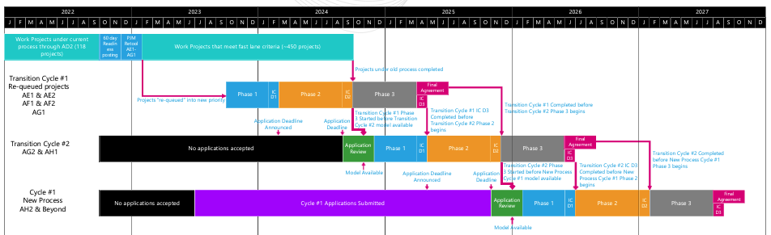
PJM Transition to Cluster Study
Reference: PJM, Thomas, Jack; “Interconnection Process Reform”, April 27, 2022

Slide 5
Objectives
Determine distribution of projects in the interconnection queue by:
Technology
MW Capacity
Location
Interconnecting Utility
Determine distribution of unit price of interconnection ($/kW).
Is there any correlation between interconnections costs and any of these factors?
Characterize the projects under some unit interconnection cost threshold.

Slide 6
Exploratory Data Analysis

Slide 7
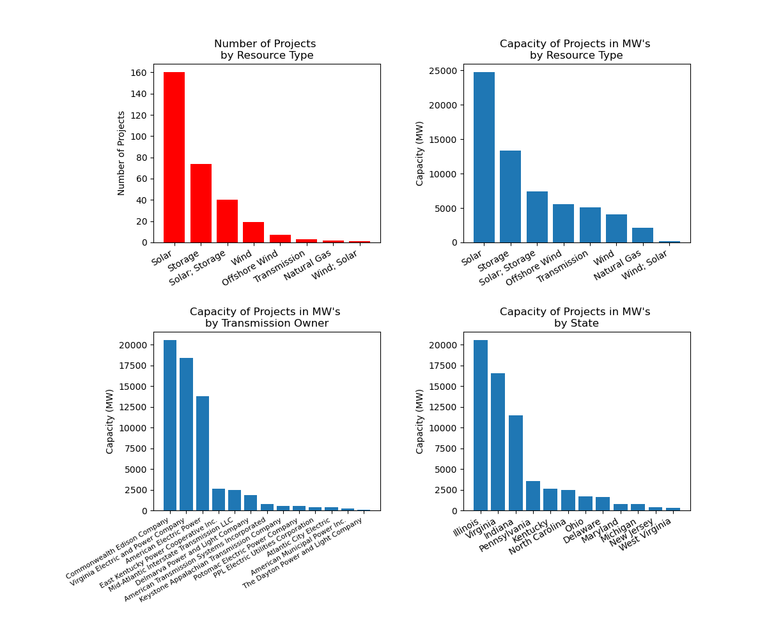
Project Characterization (TC-1)
306 total projects in TC-1
Project technology type and MW capacity is primarily solar, storage, solar + storage.
3 Transmission Owners have the most projects applying to interconnect with their systems:
ComEd
Virginia E&PC
AEP
Illinois, Virginia and Indiana dominate the project locations by total MW capacity.

Slide 8
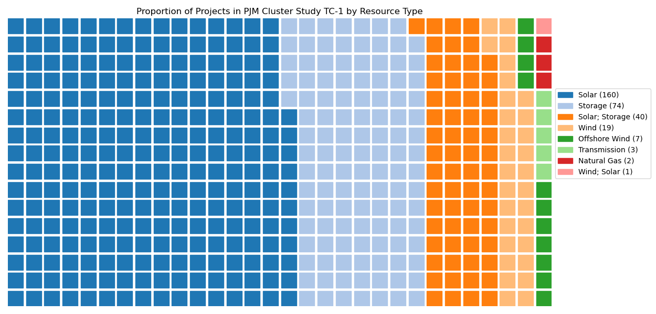
Project Distribution by Technology

Slide 9
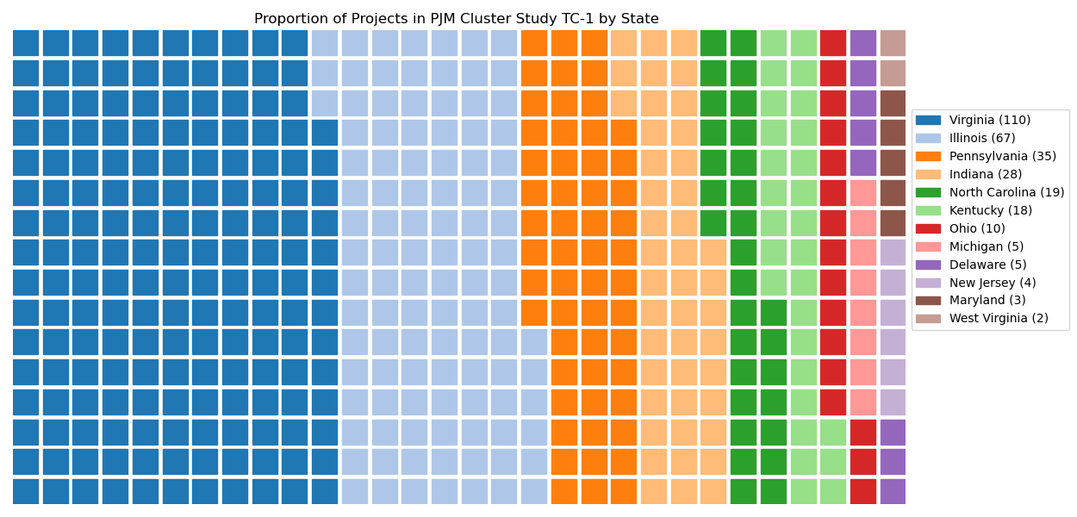
Project Distribution by State

Slide 10
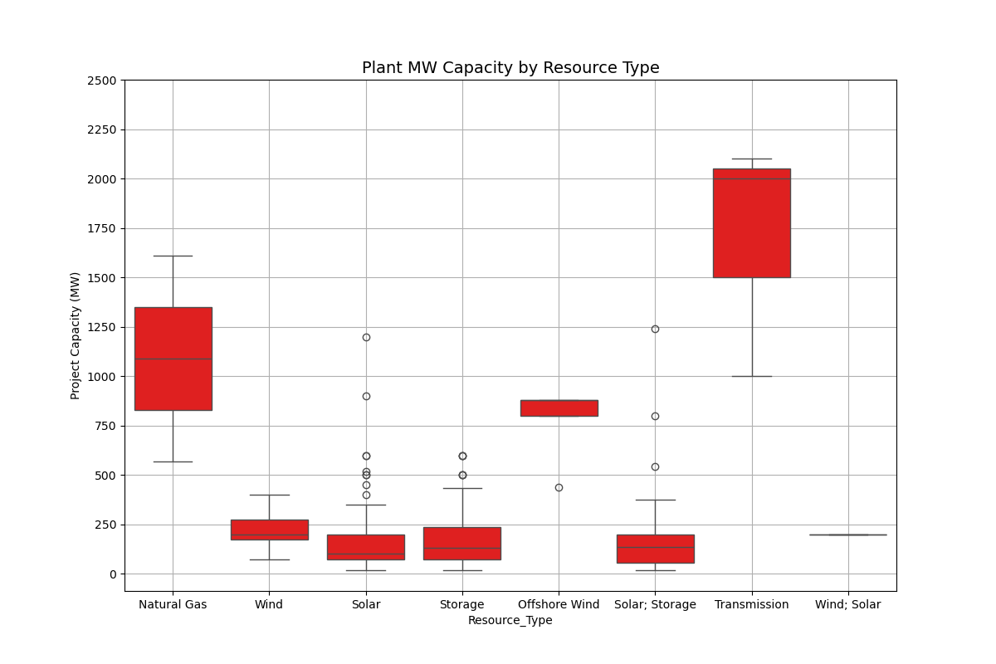
Plant MW Capacity by Resource
Natural gas, Transmission, and Offshore wind projects have median project capacities greater than 750 MW.
Wind, Solar, Storage have median project capacities of under 250MW.

Slide 11
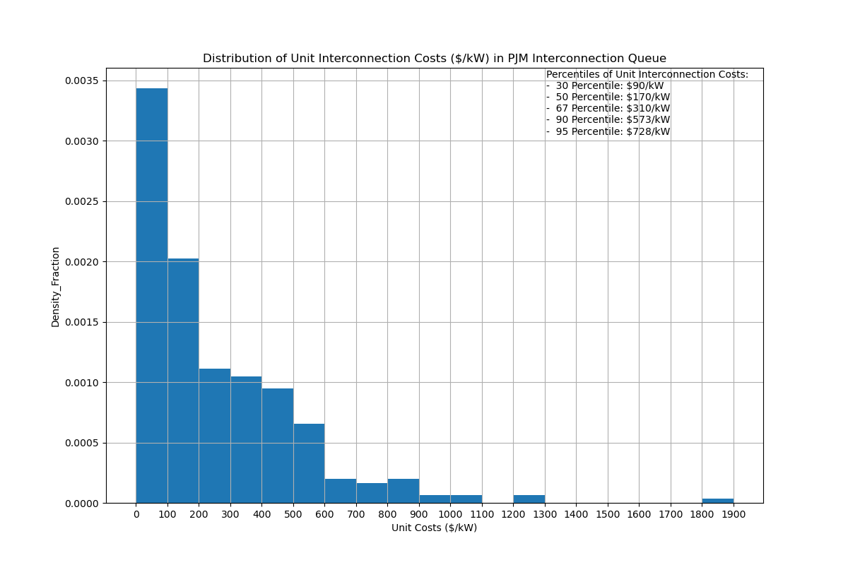
Interconnection Project Unit Cost Distribution ($/kW)
30 percentile: $ 90/kW
50 percentile: $ 170/kW
67 percentile: $ 310/kW
90 percentile: $ 573/kW
95 percentile: $ 728/kW

Slide 12
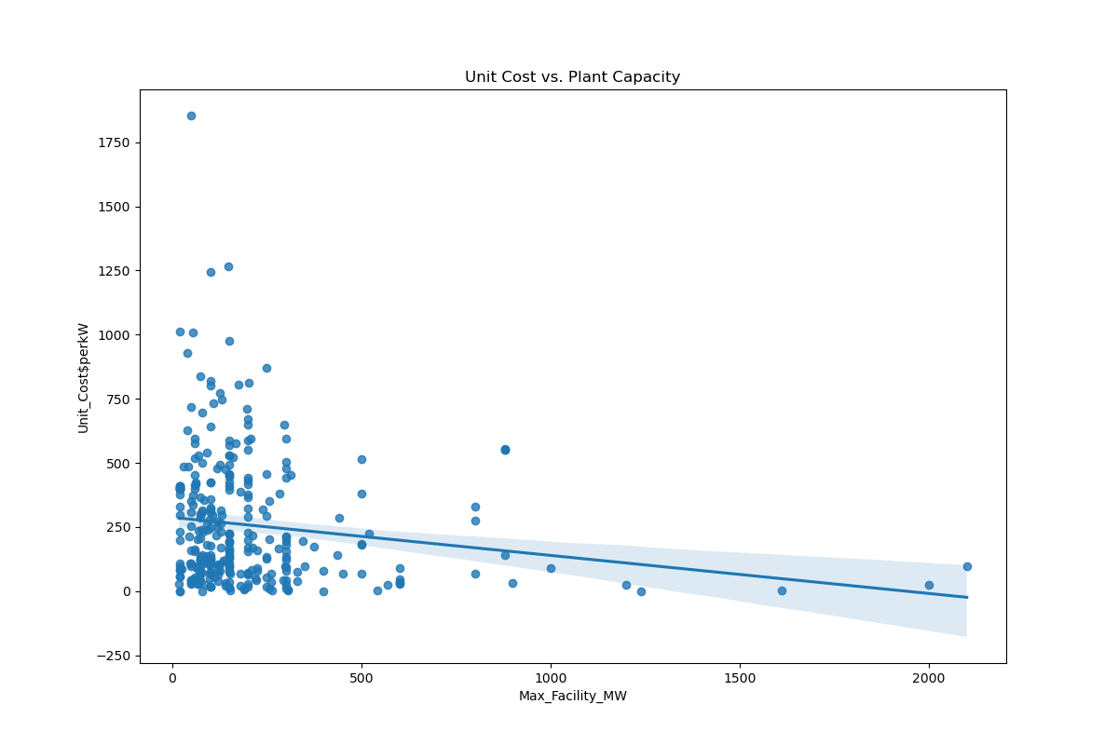
Interconnection Unit Cost vs. Project Size
Unit Cost of Interconnection $/kW) is NOT well correlated to Project Capacity (MW)
However, projects over 1,000 MW (only 2% of TC-1 projects) generally have low unit cost of interconnection

Slide 13
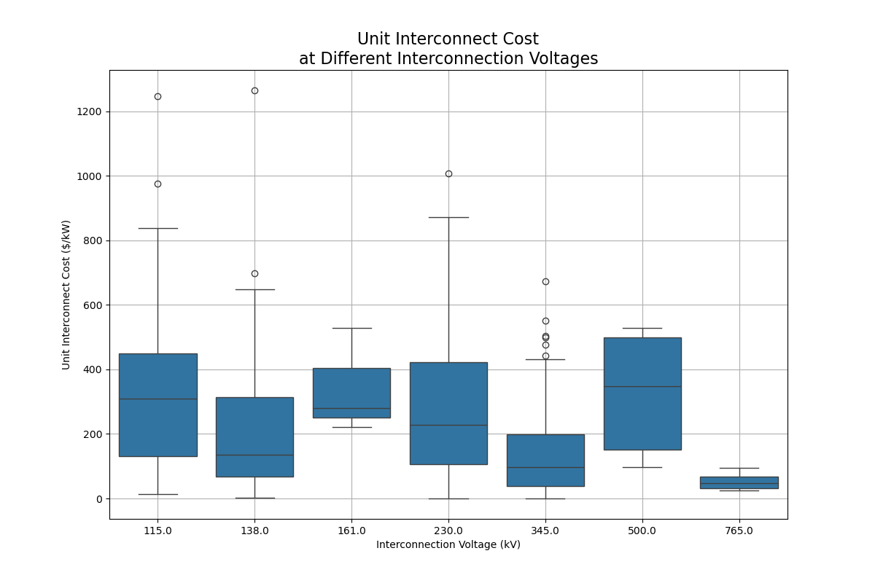
Distribution of Project Unit Interconnection Cost and Interconnection Voltages
The lowest median unit interconnection costs appear at 765kV and 345kV

Slide 14
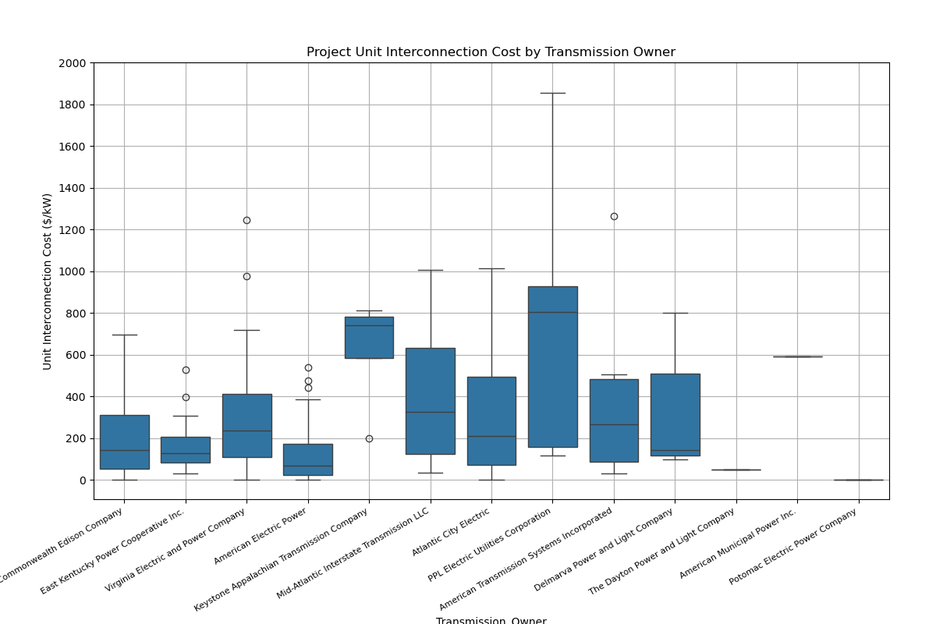
Distribution of Project Unit Interconnection Cost by Transmission Owner
Median unit costs are $300 /kW or less except for:
Keystone Appalachian Transmission Company
Mid-Atlantic Interstate Transmission Inc.
PPL Electric Utilities
American Municipal Power

Slide 15
Projects with Lowest Interconnection Cost

Slide 16
Projects with Low Cost of Interconnection
Generally, only 30% of projects which apply for interconnection proceed all the way through and sign an interconnection agreement.
Reasons may include:
Project financing or problematic project economics
Lack of or loss of developer funding
Project delay or difficulty getting permits
High Interconnection costs
It’s assumed that projects with low cost of interconnection are more likely to proceed than projects with high costs of interconnection.
Assuming true, what are the characteristics of the subset of projects in bottom 35 percentile of unit interconnection cost? ~ 100 projects

Slide 17
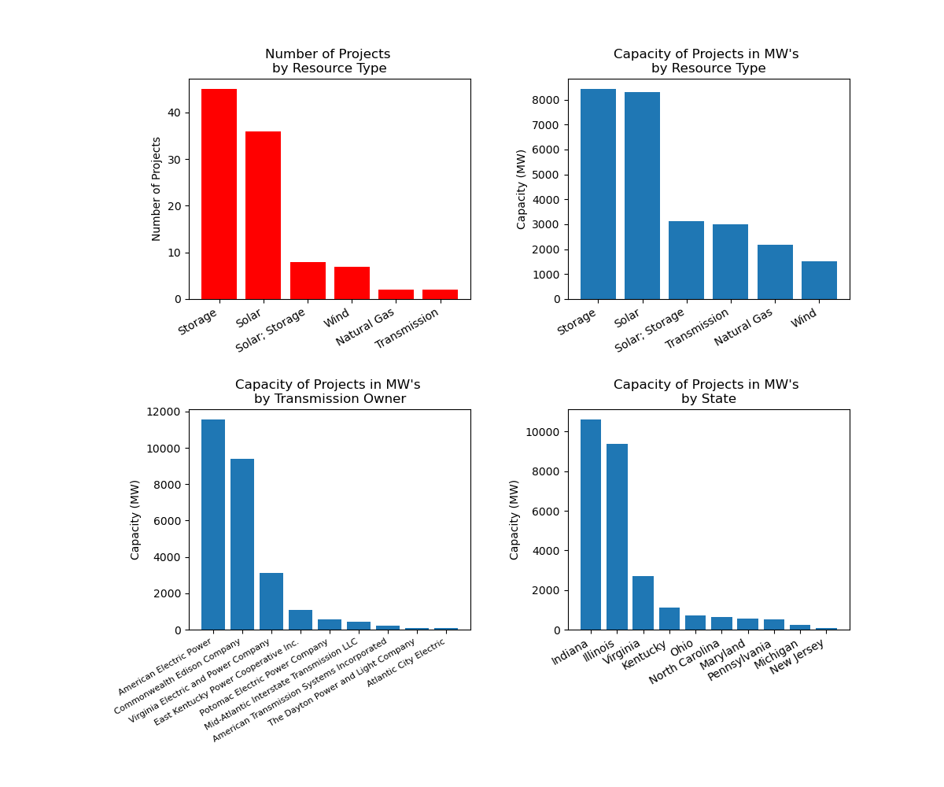
Project Characterization
Lowest 100 Unit Interconnect Cost
Storage, Solar and Solar + Storage still represent the majority of projects by count and MW capacity.
American Electric Power, ComEd and Virginia all have the most MW capacity; but ranking has changed. AEP now first, followed by ComEd
A good percentage projects with AEP as the Transmission Owner are among the lowest 100 projects.
Indiana, Illinois, Virginia still have the most projects; but ranking has changed. (was Illinois, Virginia, then Indiana)

Slide 18
Conclusions
PJM’s Transition Cycle 1 cluster of projects is comprised mostly of solar, energy storage and solar+ energy storage projects
Projects are primarily located in Virginia, Illinois and Indiana,
A high proportion of projects interconnect with ComEd, Virginia Electric Power Company and AEP
Unit Interconnection cost for projects have a median unit cost of $170/kW and 30% of projects have units costs of $90/kW or less.
A very high percentage of AEP’s projects are among the 100 projects having the lowest unit cost of interconnection.

Slide 19
Appendix
Data Source: https://www.pjm.com/pub/planning/project-queues/Cluster-Reports/TC1/TC1_PH1_Executive_Summary.htm
Interconnection Process Reform: https://www.pjm.com/-/media/committees-groups/committees/mrc/2022/20220427/20220427-item-02a-interconnection-process-reform-presentation.ashx

Slide 20
Acknowledgements
PJM makes data publicly available on their interconnection process.
This type of transparency is important for developers to understand the market.

